Slide 1
Queue

Slide 2
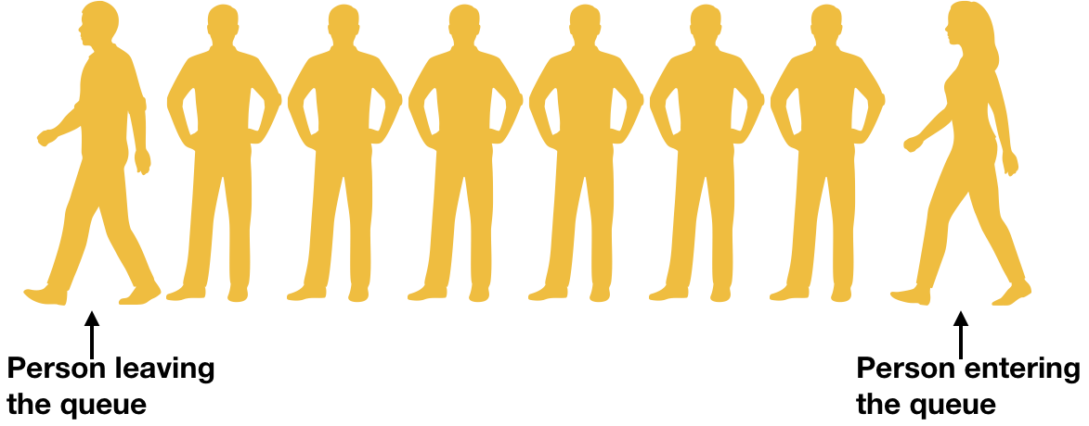
Introduction
In general, Queue is a line of person waiting for their turn at some service counter like
ticket window at cinema hall, at bus stand or at railway station etc. The person who
comes first, he/she gets the service first.
Similarly in data structure,
Queue is a linear list in which insertions can take place at one end of list, known as rear
of the list, and deletions can take place at the other end of list, known as front of list.
Nature of queue is First Come First Serve (FCFS) or First In First Out (FIFO)
Example – Printer task queue, keystroke queue etc.

Slide 3
Basic Operations
CreateQueue – Creates an empty queue
Enqueue – Inserts element into queue
Dequeue – Deletes element from queue
IsEmpty – Checks the emptiness of queue
IsFull – Checks the fullness of queue

Slide 4
Array as
Linear Queue

Slide 5
Array Representation of Queue
Queue is defined by its two pointers namely front and rear
If queue is empty then front=-1 and rear=-1
If queue is full then rear = SIZE-1 and front=0 where, SIZE is the size of array used as queue

Slide 6
Representation
5 | 6 | 4
front
rear
front=0 and rear=2
Insert (Enqueue) 15, 4,9,6
5 | 6 | 4 | 15 | 4 | 9 | 6
front
rear
front=0 and rear=6
Delete (Dequeue) 4 times
 |  |  |  | 4 | 9 | 6
front
rear
front=4 and rear=6

Slide 7
Create queue
C code:
struct queue{
int array[SIZE];
int front, rear;
};
Create queue:
Algorithm Create_Queue( struct queue *Q): This algorithm creates an empty queue i.e. it initializes rear = -1 and front = -1.
Q -> front =-1
Q -> rear = -1

Slide 8
Enqueue
This algorithm inserts an element into queue Q. Item is the element which is to be inserted.
Algorithm Enqueue(struct queue *Q, int Item) –
If (Q->front == -1 or Q->rear == -1) // Check for emptiness
Q->front = Q->rear = 0
Else If ( Q-> rear == SIZE-1) // Check for fullness
If(Q->front == 0) // Queue is full
Print “Queue Overflow”
Exit
Temp = Q->front // Temp is an integer variable pointing to front
Set i=0
While(Temp<= Q->rear)
Q->array[i] = Q->array[Temp]
Temp = Temp + 1
i=i+1
Q->rear = Q->rear – Q->front + 1 // Update rear
Q->front = 0
Else
Q->rear = Q->rear + 1
Q->array[Q->rear] = Item
Best case time complexity =O(1) and Worst case time complexity = O(n)

Slide 9
Dequeue
This algorithm deletes an element from queue Q. Item is the element which is returned after deletion.
Algorithm Dequeue(struct queue *Q)
If (Q->front == -1 or Q->rear == -1) //Check for emptiness
Display “Queue is empty”
Exit
Item = Q->array[Q->front]
If ( Q-> rear == Q->front) // Only one element
Q->front = -1
Q->rear = -1
Else
Q->front = Q->front + 1
Return Item
Best case time complexity =O(1) and Worst case time complexity = O(1)

Slide 10
Limitation of Linear Queue
If last position of queue is occupied then it is not possible to enqueue any more element even though some positions are vacant towards the front end of queue.
Solutions:
Shift the elements towards beginning (toward left) of queue and adjust the front and rear accordingly. But, if linear queue is very long then it would be very time consuming to shift the elements towards vacant positions. Hence Enqueue operation takes O(n) time.
Make circular queue

Slide 11
Circular Queue
During enqueue of an element in queue,
if rear reaches to (SIZE – 1) considering queue starting index is 0 then,
Make rear = 0
0 1 2 3 4 5 6 7
 |  |  |  | 4 | 9 | 6 | 14
front
rear
Creation of circular queue is same as linear queue.

Slide 12
Enqueue operation in Circular Queue
This algorithm inserts an element into queue Circular Queue. Item is the element which is to be inserted.
Algorithm EnCqueue( struct queue *CQ, int Item) –
If (CQ->front == -1 or CQ->rear == -1) //Check for emptiness
CQ->front = CQ->rear = 0
Else If ( CQ-> rear == SIZE-1) //1st condition to check for fullness
If(CQ->front == 0)
Print “Queue Overflow”
Exit
CQ->rear = 0 // Start inserting from beginning
Else If(CQ->rear = = (CQ->front – 1)) //2nd condition to Check fullness
Print “Queue Overflow”
Exit
Else
CQ->rear = CQ->rear + 1
CQ->array[CQ->rear] = Item
Best case time complexity =O(1) and Worst case time complexity = O(1)

Slide 13
DeCqueue
This algorithm deletes an element from queue CQ. Item is the element which is returned after deletion.
Algorithm DeCqueue(struct queue *CQ) –
If (CQ->front == -1 or CQ->rear == -1) //Check for emptiness
Display “Queue is empty”
Exit
Item = CQ->array[CQ->front]
If ( CQ-> rear == CQ->front) // Only one element
CQ->front = -1
CQ->rear = -1
Else if (CQ->front == SIZE -1) // if front points to last element
CQ->front = 0
Else
CQ->front = CQ->front + 1
Return Item
Best case time complexity =O(1) and Worst case time complexity = O(1)

Slide 14
Limitation of array Implementation
Size of queue must be known in advance. In real
scenario, it is not possible.

Slide 15
Linked List as
Linear Queue

Slide 16
Representation
front
rear
5
6
4
Insert (Enqueue) 15, 9
front
rear
5
6
4
15
9
Delete (Dequeue) 3 times
front
rear
15
9

Slide 17
Create queue
C code:
struct Node{
int INFO;
struct Node *NEXT;
};
struct Queue{
struct Node *front;
struct Node *rear;
}Q;
Create queue:
Algorithm Create_EmptyQueue( struct Queue *Q): This algorithm creates a queue with rear = NULL and front = NULL. Where front and rear are the pointers, pointing to first and last item of queue.
1. Q -> front = Q -> rear = NULL // NULL means queue is empty

Slide 18
Enqueue
This algorithm inserts an element into queue Q. Item is the element which is to be inserted.
Algorithm EnLqueue( struct Queue * Q, int Item) –
Node * New_node = Allocate memory
If(New_node ==NULL) // Only when RAM is full
Print “Queue overflow”
Exit
New_node >INFO = Item
New_node >NEXT = NULL
If (Q->front == NULL or Q->rear == NULL) //Check for emptiness
Q->front = Q->rear = New_node
Else
(Q->rear)->NEXT = New_node
Q->rear = New_node
Complexity = O(1)

Slide 19
Dequeue
This algorithm deletes an element from queue Q. Item is the element which is returned after deletion.
Algorithm DeLqueue(struct Queue * Q) –
Node *Temp
If (Q->front == NULL or Q->rear == NULL) // Check for emptiness
Display “Queue is empty”
Exit
Item = (Q-> front) ->INFO
Temp = Q->front
If ( Q-> rear == Q->front) // Only one element
Q->front = NULL
Q->rear = NULL
Else
Q->front = (Q->front)-> NEXT
Free Temp
Return Item
Complexity = O(1)

Slide 20
Deque ( Double-Ended Queue )
Linear queue which allows insertion and deletion from both the ends of list
Addition or deletion can be performed from front or rear
There are two variations of deque –
Input restricted deque – Insertions from only one end but deletion from both ends
Output restricted deque – Insertion from both ends and deletion from one end only
Insertion
Deletion
5 | 6 | 4 | 15 | 4 | 9 | 6
Deletion
Insertion
front
rear

Slide 21
Operations on deque
Insertion at beginning – Using front pointer
Insertion at end – Using rear pointer
Deletion at beginning – Using front pointer
Deletion at end – Using rear pointer

Slide 22
Priority Queue
A queue where each element is assigned a priority.
Lower the number higher the priority.
An element with highest priority is processed first before any element of lower priority.
If two elements are of same priority then they are processed according to the order in
which they were added in queue.
Priority decision parameter –
Shortest job
Payment
Time
Type of Job etc.

Slide 23
Implementation of priority queue
Linear Linked List
6 | 1
8 | 2
12 | 3
14 | 4
front
rear

Slide 24
Create priority queue
C code:
struct Node{
int INFO;
int priority;
struct Node *NEXT;
};
struct Queue{
struct Node *front;
struct Node *rear;
}Q;
Create queue:
Algorithm Create_PQueue(Q): This algorithm creates a queue with rear = NULL and front = NULL. Here, Q is a linked list. front and rear the pointers, pointing to first and last item of queue.
1. Q -> front = Q -> rear = NULL // NULL means queue is empty

Slide 25
Insertion in priority queue
Make node with provided item and assigning priority
Insert at proper place according to priority
11 | 3
6 | 1
8 | 2
12 | 3
14 | 4
front
rear

Slide 26
Applications of priority queue
Very useful in scheduling –
- Traffic light
- Job scheduling in operating system
Bandwidth management –
When higher priority customer needs more bandwidth, all other lower priority
customer are blocked for some duration. Here, priority may be according to plan
which customer use.
Huffman coding –
To transmit the data efficiently on network.

